Slide 1


Getting Graphic:
The value of graphic
novels in
literacy instruction.
Part I:
The “what & why?”
Presented by:
Wes Young

Slide 2


Familiarity with the type
The
Everyday
Who here has had an experience, personal or otherwise, with comics and/or GNs?
What comes to mind when you think of “comics” or “graphic novels”.
Playing against type.

Slide 3
Nonfiction in the form
Subjects include:
Biography
Historical events and eras
War and conflict
Medicine
Sociology
Psychology
Geography and culture
Family
The
Everyday
What we call the human experience!

Slide 4
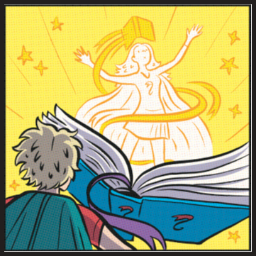
Why Graphic Novels?
A way to engage reluctant and struggling readers
Addresses three of the four learning types (making lessons kinesthetic is up to you )
Accessibility and cost
Depth of subjects and relatability to everyone
Rich tradition outdating prose form
The
Everyday
Plus, graphic novels are cool, but not too cool for school ;)

Slide 5

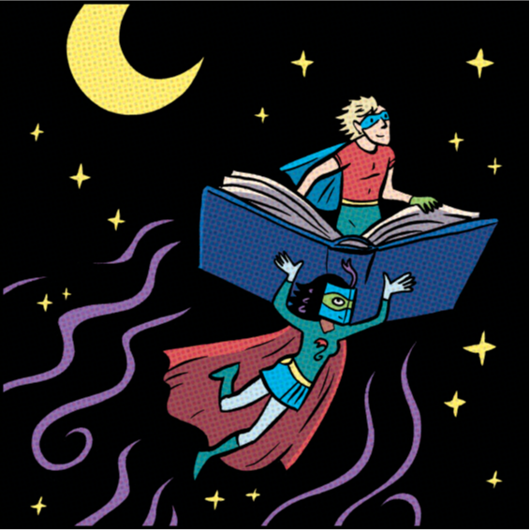
QUESTIONS or:
“I’m not sold yet, tell me more!”
???

Slide 6


The
Everyday
Part II:
The “who?”

Slide 7
Basic Literacy (ABE)
Adaptable to any level, even those with below a first grade reading level.
Intimidation and the struggling reader…
Tiers 1, 2 & 3 vocabulary development.
Creating good habits.
The
Everyday

Slide 8
English as a second language (ESL)
In addition to ABE skills…
Teaching points in cultures, personal histories and experiences.
Biographies and relatability.
Grammar exposure and natural language.
Progression
The
Everyday

Slide 9
High school equivalency(HSE):
Social Studies
In addition to ABE & ESL skills…
History and Geography focus in context.
Map reading and timelines.
(requires the most extra effort for the tutor/teacher)
The
Everyday

Slide 10
High school equivalency(HSE):
Language Arts
In addition to ABE & ESL skills…
Comprehension, challenge and applicability.
Writing prompts, writing prompts, and writing prompts.
Academic vocabulary development.
Any number of possible lessons paths.
The
Everyday

Slide 11
QUESTIONS or:
“I see many trees and/or a blurry forest.”
???

Slide 12
Part III:
The “how?”
The
Everyday

Slide 13
Arlington Reads
Presents:
Graphic Novels
This is Book 1:
Origin Story
Wes Young - Instructor
Course:
April 19th –
June 7th
(8 weeks)

Slide 14
Saving the Day!
There are many purposes for this class and many subjects addressed.
This is an adult education class, and materials may include adult language and adult themes.
Foes will be vanquished
and fun will be had!
The
Everyday

Slide 15



The mission…
There will be studies of vocabulary , writing assignments and even homework!
There will be discussions on culture & history.
This class is as much about you and your experiences as it is about the novel we study.
You will be required to think, possibly in unique or different ways.
ALERT! Did I mention that this is an educational class?! Even so, it will be different and it will be fun!

Slide 16
QUESTIONS or:
“I’ve made a terrible mistake!”
???

Slide 17




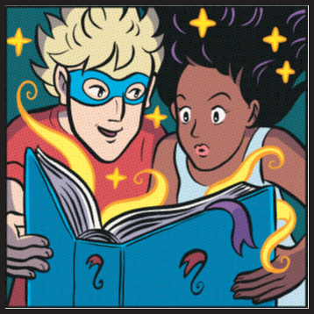
What is a
graphic novel?
“Sequential Art.”
vs.
“Juxtaposed pictorial and other images in deliberate sequence, intended to convey information and/or produce an aesthetic response in the viewer.”
History dates back to the 1000s. A manuscript discovered by Cortes in 1519 dates back to 1049.

Slide 18


Comic Books
Graphic Novels
Single issues (serialized)
Around 20 pages long
Started in 1933 (U.S.)
Exclusively fiction
Stand-alone or collected serialized works
50 – 1000+ pages long
Origins in the 1960s
Not to be confused with comic strips, which are found in newspapers and magazines
Can be works of fiction or non-fiction

Slide 19
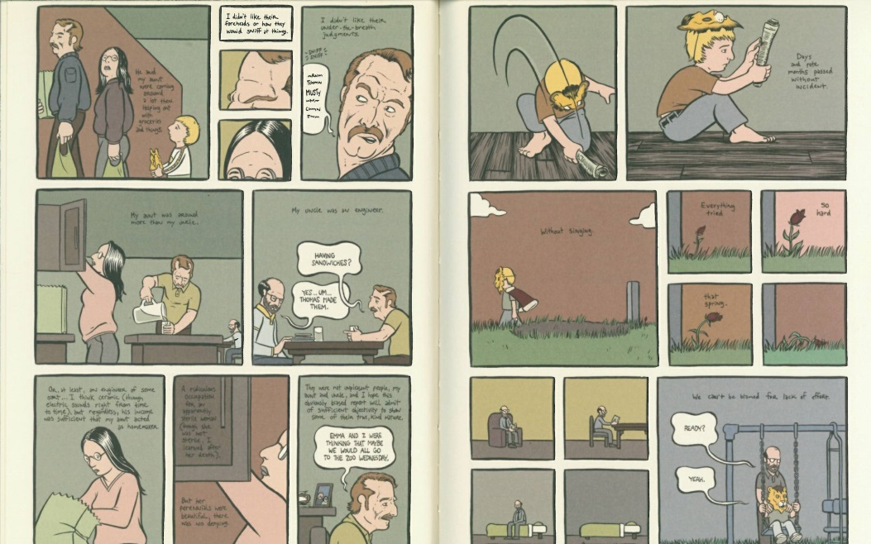
How to Read a graphic novel: Panels I - order

Slide 20
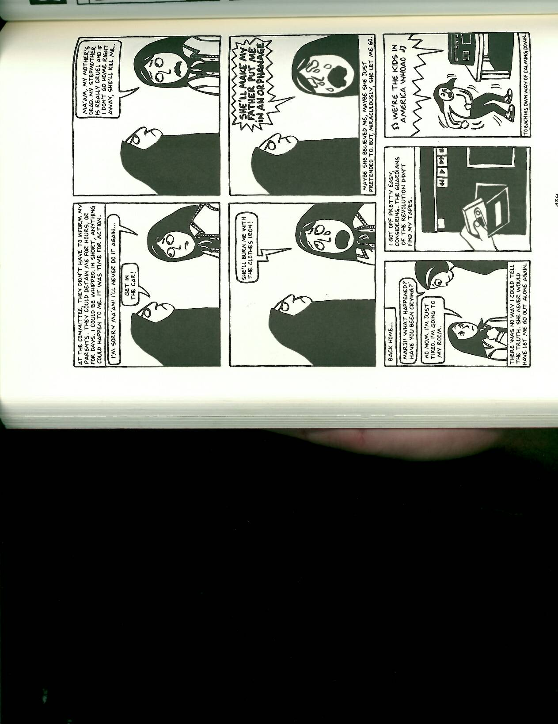
How to Read a graphic novel: Text Bubbles I - basics
Narration, inner thoughts
Standard dialog
Exclamation, extreme emotion
Emotion, variation
Noise, shouting

Slide 21
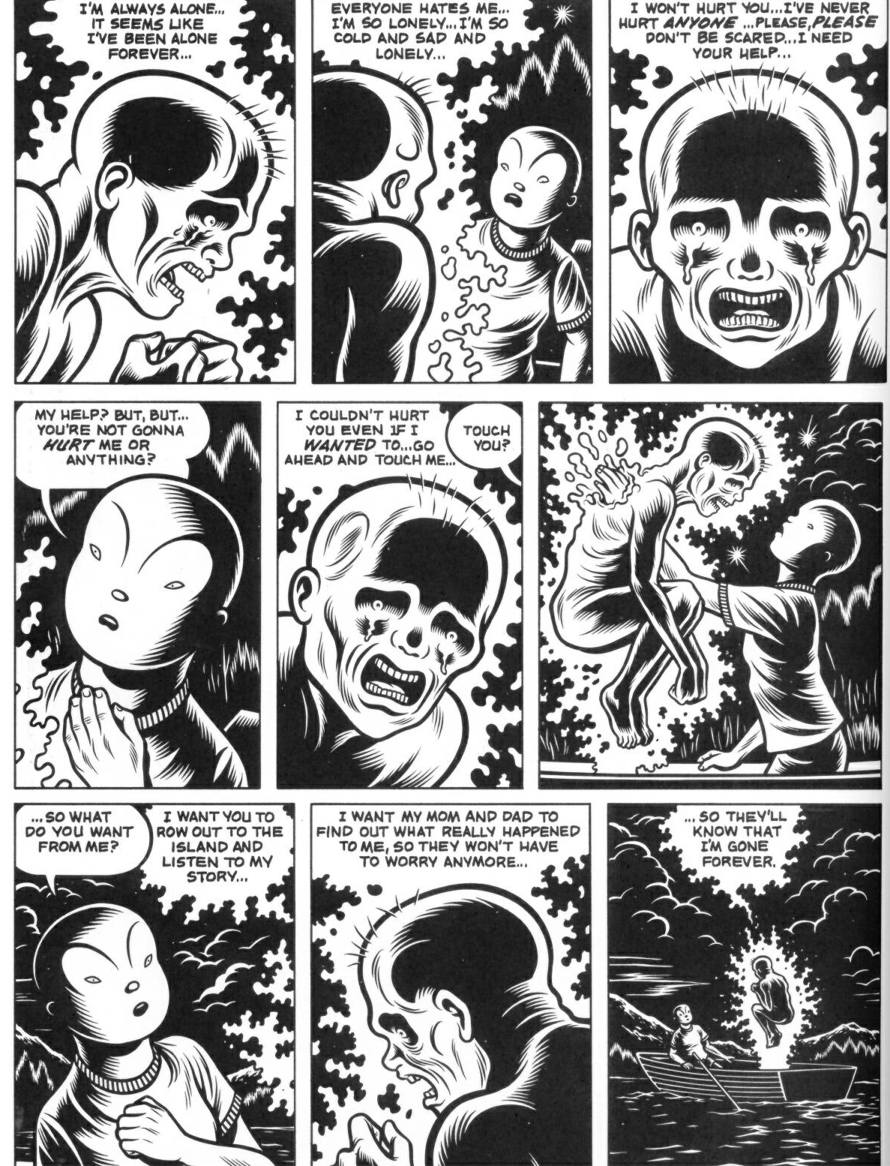
How to Read a graphic novel: Text Bubbles II - extension
As an expression of the character.

Slide 22
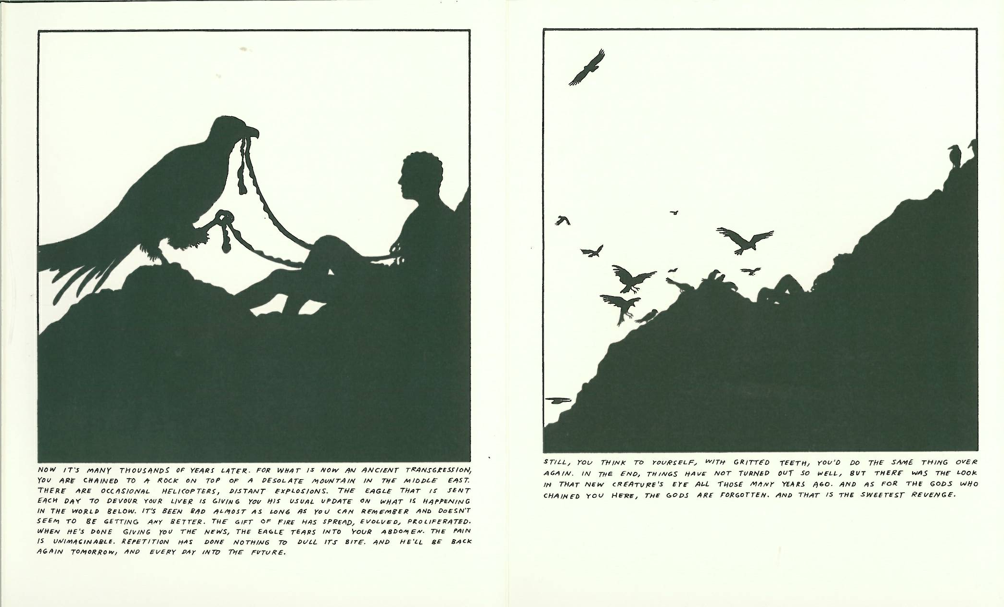
How to Read a graphic novel: Art & Imagery

Slide 23
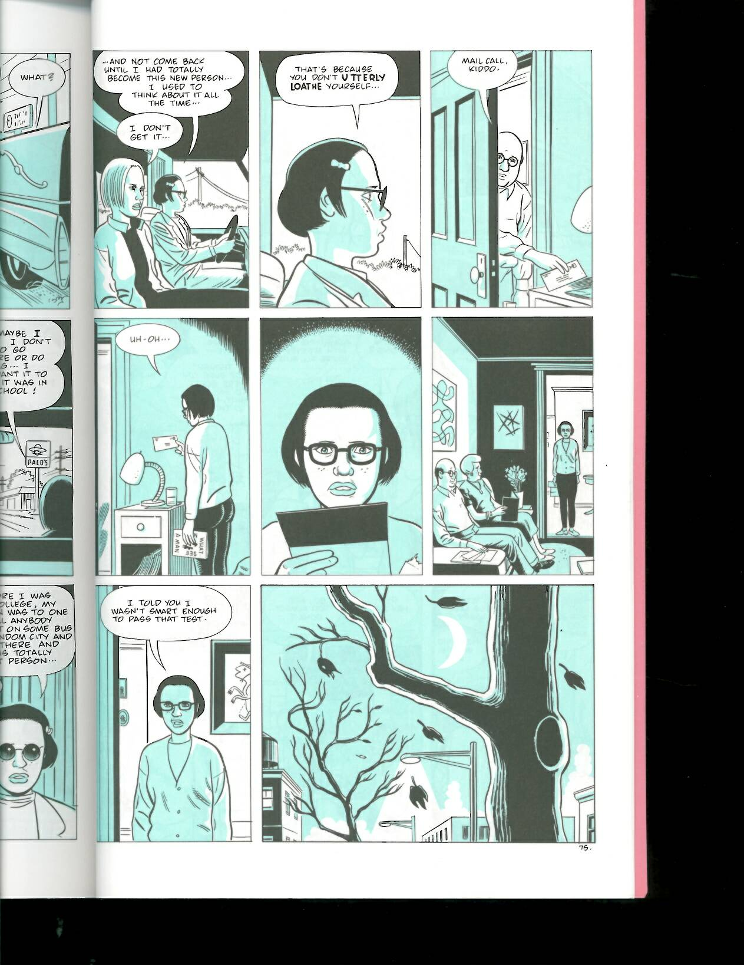
How to Read a graphic novel: Panels II – the space between

Slide 24
QUESTIONS or:
“I was okay at first but now I want to leave…”
???

Slide 25

Maus: A survivor’s Tale
Book I – My Father Bleeds History
Written and illustrated by Art Spiegelman and published in 1991.
Serialized 1980-1986 with the seeds of the story as early as 1972.
This is a work of non-fiction, known as a biography.

Slide 26
The novel
History
About Art’s father
Mid-1930s- Winter 1944
Deals with everyday life and the changing political climate
Setting: Poland (past) & New York (present)
WWII 1939-1945
Adolf Hitler: 1921-1945
European theatre
Racism and thought
Many different factors contributed to World War II, this work depicts a biased view.
Art conducted a series of interviews with his father, many of which he depicts in the story.

Slide 27
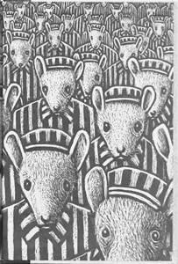
Important features
of Maus:
Characters are anthropomorphic.
Often considered the first/second GN to bring relevance to the form.
Is the only GN to win a Pulitzer Prize (1992).
Is on Time magazine’s top 100 nonfiction books of all time (7th).
Themes of Memory, Language, Presentation, Racism, & Guilt.

Slide 28
The main characters…
Present Day.
1930-1944
Anja Spiegelman – Vladek’s first wife
Richieu Spiegelman – Vladek & Anja’s first child
Art (Artie) – Author, Illustrator, Son
Françoise Mouly – Art’s wife
Vladek Spiegelman – Father
Mala Spiegelman – Vladek’s wife (2nd)
This class is as much about you and your experiences as it is about the novel we study.
You will be required to think, possibly in unique or different ways.
There are 30 characters in Maus, but the rest are secondary or tertiary and show up little.

Slide 29

QUESTIONS or:
“Everything is clear and I’m ready to begin my graphic journey!”
???

Slide 30
The
Everyday
Part IV:
The “where?”

Slide 31
Where do I begin, as a teacher wanting to learn more myself?
Understanding Comics: The Invisible Art by Scott McCloud
Comics and Sequential Art: Principles and Practices from the Legendary Cartoonist by Will Eisner
Journal articles, available on Google Scholar
The
Everyday
While useful, these books only provide a history and foundational blueprint.
The GNs you use will carry the weight of instruction ☺

Slide 32
Where do I begin, as a teacher selecting a graphic novel?
Maus, A survivor’s Tale by Art Spiegelman
Persepolis: The Story of a Childhood by Marjane Satrapi
Trinity: The Graphic History of the First Atomic Bomb by Jonathan Fetter-Vorm
Marzi by Marzena Sowa
Pyongyang; Shenzhen; Burma Chronicles; Jerusalem all by Guy Delisle
Works by Joe Sacco
My Friend Dahmer by Derf Backderf
Buddha (series) by Osamu Tezuka
The
Everyday

Slide 33
Where do I find graphic novels on a budget?
Small program, individual, little funding or DIY? Fear not!
Local public library
Half Price Books or other used book sellers
Amazon, Better World Books, Abebooks, Thrift Books
The
Everyday

Slide 34
The
Everyday
Part V:
Conclusion
Wes Young
Literacy Coordinator –
Arlington Reads
Wesley.young@arlingtontx.gov

