Slide 1
Success for Adult Learners

Slide 2
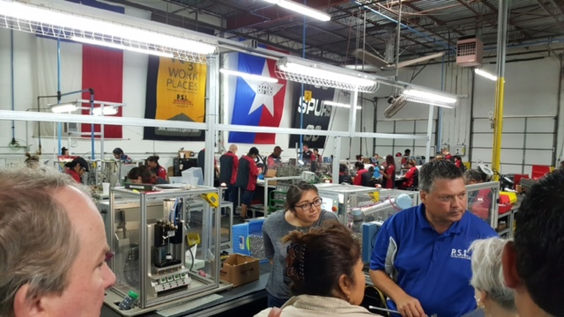
Contextualized Learning through
AEL Teacher Externships
Pressure Systems International(PSI)
Presented by: Wendy Christensen & Michelle Yzaguirre
Notes:
This Externship Program provides teachers with opportunities to learn about the manufacturing industry and careers available. Teachers tour 5 San Antonio Manufacturing facilities, interacted directly with company employees, and collaborated with other adult education teachers to bring back lessons learned and educate their students and peers.
We are excited to share the development and implementation process for our first annual AEL Alamo Consortium Teacher Externship Week. We partnered with a local non-profit organization of manufacturing companies to host an AEL teacher experience unlike any before in the San Antonio area. Our Teacher Externship Week allows teachers to experience job sites otherwise off-limits to educators, share these experiences with their students. Our efforts resulted in a first place award for AEL Employer Partnership from TWC. We will take you through the idea, implementation, and lessons learned. Education Service Center, Region-20 (ESC-20) is excited to share the development and implementation process for our first annual AEL Alamo Consortium Teacher Externship Week. ESC-20 partnered with a local non-profit organization of manufacturing companies to host an AEL teacher experience unlike any before in the San Antonio area. Our Teacher Externship Week allows teachers to experience job sites otherwise off-limits to educators, share these experiences with their students, and create lesson plans to share with other teachers. The team’s efforts resulted in a first place award for AEL Employer Partnership from TWC. Join us to explore the journey of Teacher Externship from idea, implementation, and lessons learned.

Slide 3
Can you answer these questions?
What are the top industries in your local workforce area?
Who are the top employers in your area? Who are the smaller employers in your area?
What specific education, skills, and character traits are local employers looking for in prospective employees?
Do you and/or teachers within your organization know the answers to 1-3?
Do students within your organization know the answers to 1-3?

Slide 4
Objectives for Today
Describe the AEL Teacher Externship project.
Identify key stages in implementing an effective AEL Teacher Externship.
Discuss how the AEL Teacher Externship helped cultivate strong employer partnerships.
Reflect on how to start a AEL Teacher Externship in your service area.

Slide 5

Our Inspiration:
Alamo Stem Workforce Coalition(ASWC) Team Members

Slide 6
Alamo STEM Workforce Coalition Overview
https://youtu.be/_SXmMCTPYWI
For more information go to http://www.ateams-sa.org/
Notes:
https://youtu.be/_SXmMCTPYWI

Slide 7
Externship Objectives
Teachers
Enhance contextualized teaching practices
Students
Prepare students for what employers really need & want
Workforce
Increase awareness of high demand occupations in local workforce area

Slide 8
Objective #1: Teachers- Enhance contextualized teaching practices
Upon completion of site visits, teachers work in pairs or small groups to create lesson plans for use in the AEL Classroom.
Lesson plans posted on Consortium website.
Share experiences and lessons with peers.
Utilize experience to improve student teaching.

Slide 9
Objective #2: Students- Prepare students for what employers really need & want
What factors are most important to employers?
What are common problems employers deal with?
What do employers expect from prospective employees?
How do we match student goals to employer needs?

Slide 10
Objective #3: Workforce- Increase awareness of high demand occupations in local workforce area
Local companies
High demand occupations in the San Antonio area
Required academic skills
Desired employability/success/interpersonal skills
Education requirements for various careers
Opportunities for students

Slide 11
Things we did.
Led & facilitated the externship
Teachers selected by the program directors
Created 5 day agenda
Arranged industry tours (with assistance from Dr. Lazor/ATEAMS)
Arranged for Workforce Solutions Alamo to present on local data trends & job market in San Antonio
Chose 5Es lesson plan template (Added the best lesson plans created to our webpage.)
Paid teacher stipends
Provided lunch (with local funds)
Purchased mini iPads/cases
Purchased Nepris licenses
Created end of session survey (SurveyMonkey)

Slide 12
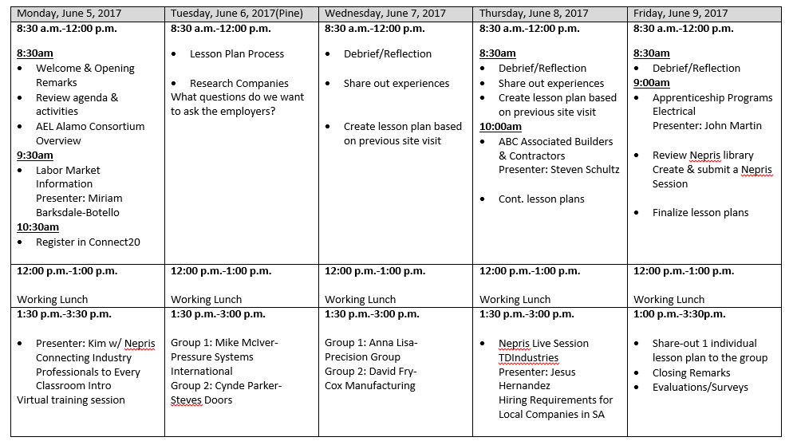

Slide 13
Guidance to Teachers
As you tour the facilities, think about how you can develop contextualized lesson plans that prepare your students for both their academic and career goals in manufacturing, construction and apprenticeship programs.
Site visits: Pressure Systems International, Steve’s Doors, Precision Group, Cox Manufacturing
What questions are you going to ask the employer?

Slide 14
Lesson plans should include:
academics
  RLA
  Math
  Science
  Social Studies
Marketable skills
  COMMUNICATION
  Critical Thinking
  Time management
  Team work
  Digital Literacy
Success for Adult Learners
Notes:
Research your company
Vision, Mission, Values
HR Policies

Slide 15
Lesson Plan Process included these key components:
Engage
Explore
Explain
Elaborate
Evaluate
Employability Skills Framework
-Applied Knowledge
-Effective Relationships
-Workplace Skills
Notes:
Refer to lesson plan

Slide 16
The Employability Skills Framework is a one-stop resource for information and tools to inform the instruction and assessment of employability skills.
Applied Knowledge
Applied Academic Skills
Critical Thinking Skills
Effective Relationships
Interpersonal Skills
Personal Qualities
Workplace Skills
Resource Management
Information Use
Communication Skills
Systems Thinking
Technology Use
http://cte.ed.gov/employabilityskills/
Success for Adult Learners

Slide 17
Teacher Presentations
How will you showcase your lessons?
1 contextualized lesson plan per site visit
You will present 1 lesson to the group
Answer these questions:
  What did you learn and implement from you site visit?
  What lessons did you create?
  Which industry did you connect in your lesson?
  How did you make connections to career and/or industries?

Slide 18
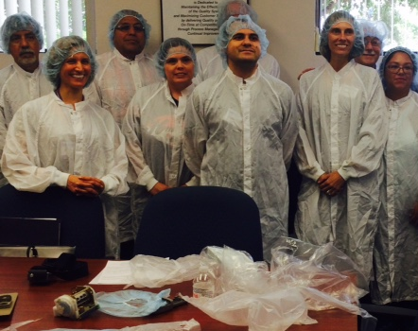
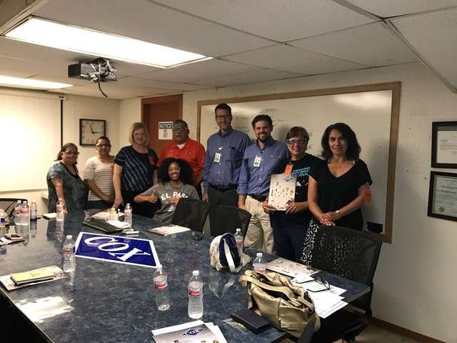
Geared up & ready for their tour
@ Cox Manufacturing
@ GW Plastics

Slide 19
COX Manufacturing
https://youtu.be/v_xDBqx9r7Q

Slide 20

EO2 Concepts
https://youtu.be/kfUiXAGGECk
Notes:
Partnered with Marathon Medical on its federal supply schedule contract administers by the Dept of VA making the Trans CU 02

Slide 21
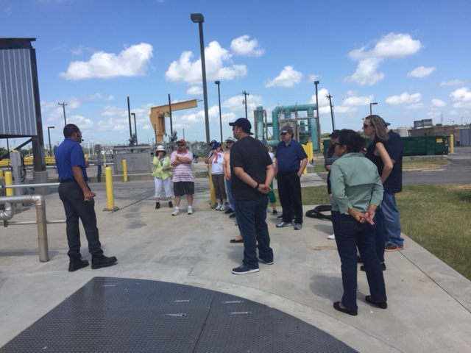
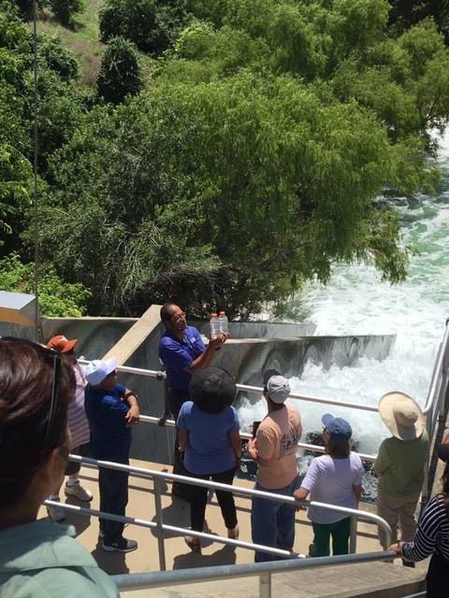
@ SAWS Dos Rios Water Recycling Center

Slide 22
Bridging the gap between industry & education
Nepris believes that a single interaction can change a life. Through their platform, students across the country virtually connect with professionals from all walks of life - scientists, engineers, artists, musicians, doctors, astronauts, writers, officials - to discover the jobs that await them and build the skills they need to be successful
https://www.wevideo.com/view/952925275

Slide 23

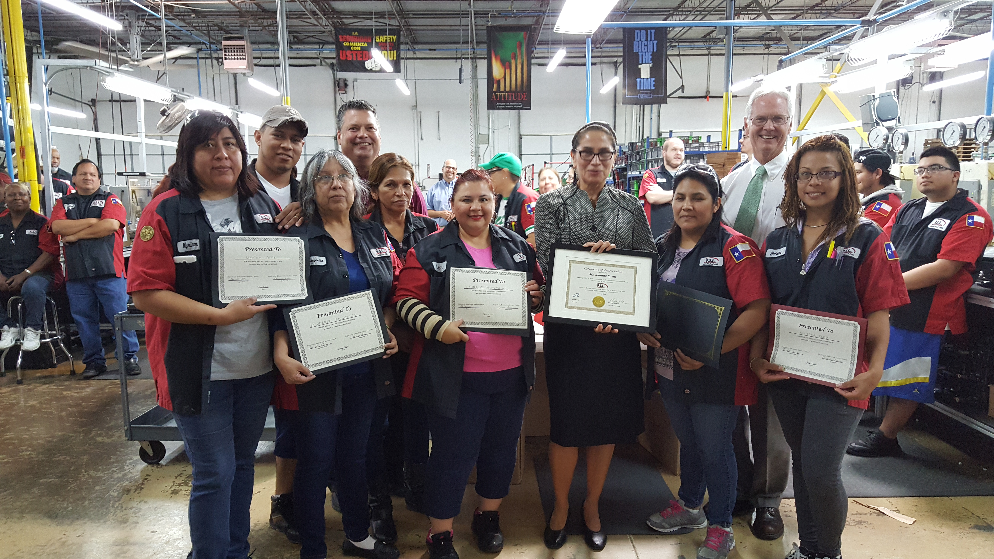
ESC-20 & PSI Partnership
https://youtu.be/FSGPMe295hw
Notes:
Meeting and speaking with local employers led to new opportunities and partnerships!

Slide 24
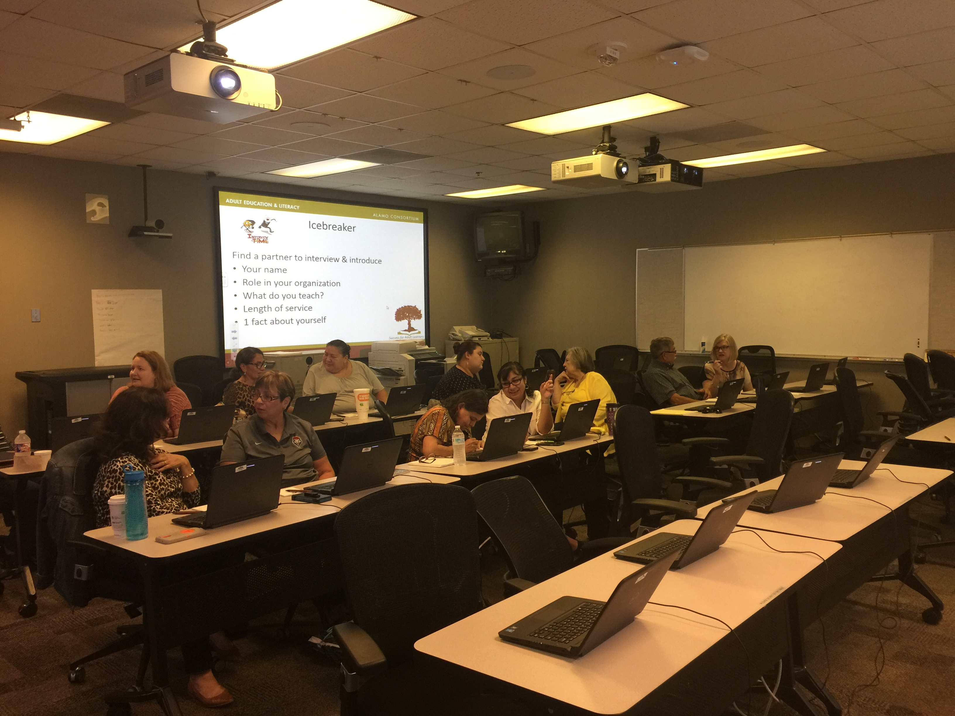
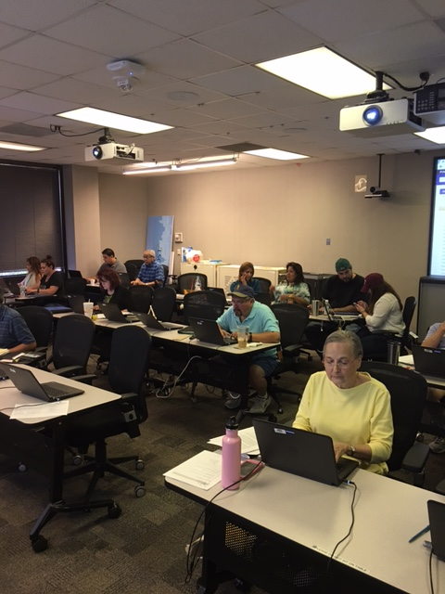
Teachers at work.

Slide 25
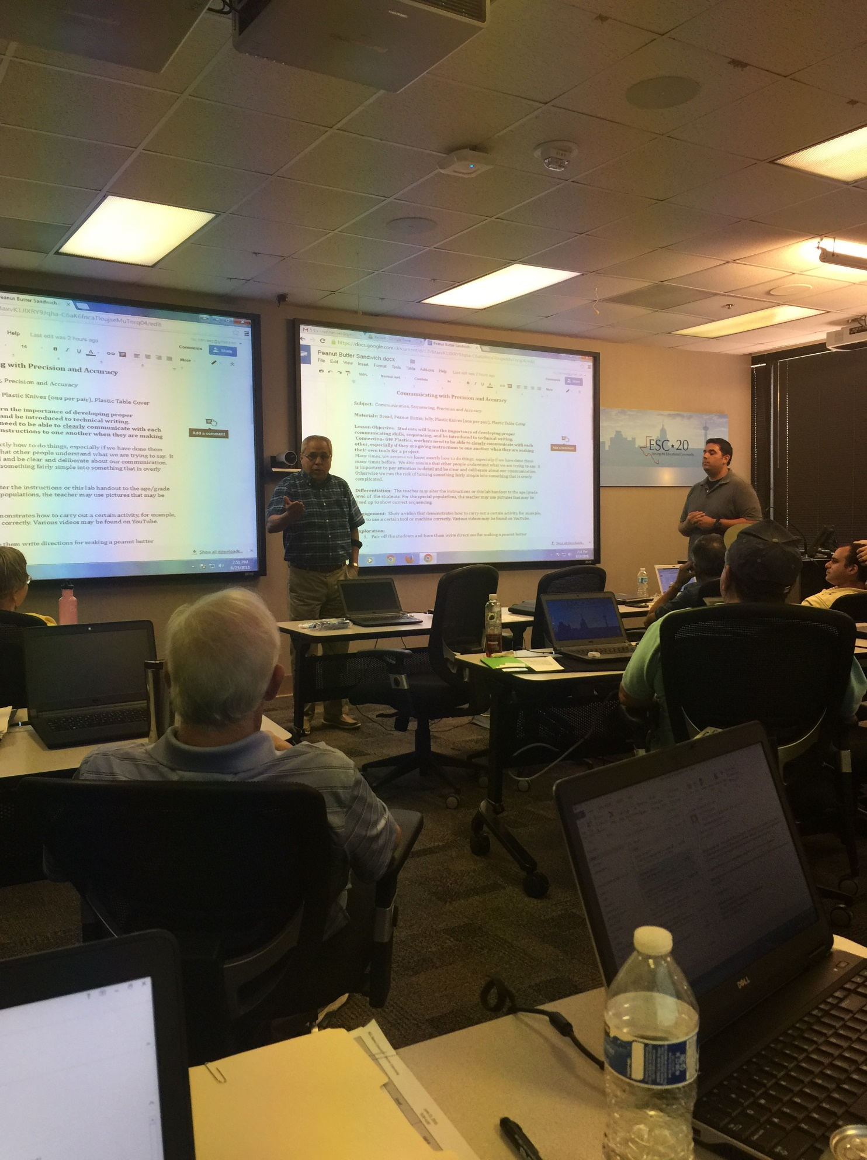
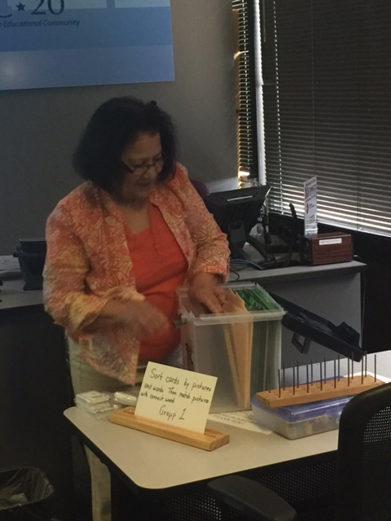
Roy & Daniel presenting on the last day!
2016
2017
Gloria presenting on the last day!

Slide 26
How much did it cost?
2016
ATEAMS contract/printing | $ 3,000.00
Teacher Stipends | $ 6,800.00
Bus rental | $ 598.00
Lunch | $ 1,000.00
ESC-20 conference room | $ 800.00
Grand total | $12,198.00
2017
ATEAMS contract/printing | $ 2,600.00
Teacher Stipends | $11,000.00
Mini Ipads/cases | $ 5,116.00
Nepris Licenses | $ 1,500.00
Lunch | $ 1,000.00
ESC-20 conference room | $ 800.00
Grand total | $22,016.00
In-Kind:
Michelle & Wendy planning & facilitating Workforce Solutions Alamo
Success for Adult Learners

Slide 27
Lessons Learned
Not long enough (days & time)
Keep post-visit discussions focused
Not enough time to plan lessons
Not enough modeling of Lesson Plan process
Didn’t provide follow-up to the participants

Slide 28
End of Session Survey Highlights
Q9 How do you plan to use this information you learned during this training?
“Conceptualization and real-world application are not new concepts. However, first-hand exposure to what employers are looking for results in creation of classroom lessons that are much more accurate and that will have a greater impact.”
Q10 What improvements do you recommend for this training?
“I had not used the 5E LP format previously, so it was time-consuming for me to complete them. However, I'm glad I used them now -- a specific type LP I can use in my teaching. Presentation minute allotment suggestion: If a group, then divide their time allotment by the number of presenters. I felt rushed and stressed about it, but it was definitely a great activity for our class.”

Slide 29
End of Session Survey Highlights
Q11 Please rate your overall experience during this training.
80% Excellent and 20% above average.
Q12 Would you recommend this training other AEL instructors?
All responses were YES
Additional comment?
“I enjoyed every minute of the week. This training was worthwhile, fun, enlightening, purposeful, relevant.....and I could go on. It was just great and I can't say enough good things about it. I so appreciate all the effort that was put into the activities of the week.”

Slide 30
Thank you!
Feel free to contact us.
michelle.yzaguirre@esc20.net
wendy.christensen@esc20.net

